Slide 1

System Administration-CSNW3203-ITNT403
Chapter 8: Network configuration
8.1 Understating Different types of Network Interfaces
8.2 Configure Ethernet Interface
8.3 Enable Basic Routing
Chapter 9: System Backup
9.1 Understand the need of Backup
9.2 Understands different types of backup
9.3 Differentiate between backup utilities.
9.4 Backup Configuration
Chapter 10:
10.1 Advanced Storage Administration
10.2 Understand the importance of Advance Storage
10.3 Understanding different RAID Levels
10.4 Create Logical Volume Management (LVM)
10.5 Modifying Logical Volume Management (LVM)

Slide 2
Understating Different types of Network Interfaces
A network interface is the point of connection between a computer and a network.
Loopback Interface (lo)
Used for local communication within the system.
IP: 127.0.0.1
Useful for testing and internal services.
Ethernet Interface (eth0)
Wired network interface.
Typical for desktops and servers.
Modern Linux systems often use predictable interface names like enp0s3
Wireless Interface (wlan0)
Wireless (Wi-Fi) network card.
Used in laptops, phones, and some IoT devices.
Names like wlan0 (older) or wlp2s0 (newer naming convention).
Command: List All Interfaces in Linux
The ip link show command in Linux is used to display information about all network interfaces on the system.
ip link show
The ifconfig -a command in Linux is used to display all network interfaces, including those that are currently down (inactive)
ifconfig –a
The ip a command in Linux is a short form of ip address show, and it's used to display all IP addresses and network interfaces on your system
ip a

Slide 3
Configure Ethernet Interface
The ifconfig command in Linux stands for "interface configuration" and is used to view and configure network interfaces.
ifconfig has been there for a long time and is still used to configure, display and control network interfaces by many, but a new alternative now exists on Linux distributions which is much more powerful than it.
Configure an IP address 192.168.1.10 and 255.255.255.0 and default gateway 192.168.1.1 as the network interface eth0.
ifconfig eth0 192.168.1.10 netmask 255.255.255.0
Delete an IP address as the network interface eth0.
ifconfig eth0 0.0.0.0
The iwconfig command in Linux is used to configure wireless network interfaces.

Slide 4
Configure Ethernet Interface
This activates the eth0 interface, making it ready for use.
ifconfig eth0 up
This deactivates the eth0 interface, making it ready for use.
ifconfig eth0 down
The ip a command in Linux.
It’s used to display all IP addresses and related configuration for your network interfaces. The ip command in Linux is a powerful utility for network configuration and management. It allows users to interact with various networking components such as network interfaces like eth0 and loopback interfaces.
A hostname command is used to view a computer’s hostname. A hostname is a name that is given to a computer that attached to the network that uniquely identifies over a network.
-i option shows loopback address
-I option establishes all configured network interfaces and shows all network addresses of the host.
The ping command is used to test connectivity to another host.

Slide 5
Configure Ethernet Interface
netstat command
The netstat command in Linux is used to display
Active Internet connections
Active UNIX domain sockets
Active Bluetooth connections
netstat –r command is used to display kernel IP routing table.
Add MAC address on eth0
ifconfig eth0 hw ether AA:BB:CC:DD:EE:FF
Enable Basic Routing
Add default gateway 192.168.1.1 as the network interface eth0.
route add default gw 192.168.1.1 eth0
View the Routing Table:
ip route show
To Delete Default Gateway:
route del default gw 192.168.1.1
The traceroute command in Linux is used to track the path that packets take from your system to a destination host across a network.

Slide 6
Chapter 9: System Backup
9.1 Understand the need of Backup
9.2 Understands different types of backup
9.3 Differentiate between backup utilities.
9.4 Backup Configuration

Slide 7
Backup
Understanding the need for backup in Linux (or any OS) is fundamental to maintaining system reliability, data integrity, and business continuity.
Taking full backup of system may not be ; for example, the /proc and /sys filesystems
The obvious things to back up are user files (/home) and system configuration files (/etc)
Generally it is good idea to backup everything needed to rebuild the system as fast as required after a failure.
Why backups are essential in Linux:
1. Protection Against Data Loss
Accidental deletions, software bugs, or file overwrites happen often.
Backups ensure you can recover lost or corrupted files quickly
2. System Recovery After Failure
If your system becomes unbootable due to:
Kernel panic
Disk failure
Corrupted configurations (e.g., /etc)

Slide 8
3. Defense Against Malware / Ransomware
Although Linux is relatively secure, malware and ransomware can encrypt or delete files.
Regular backups mean you can wipe and restore safely.
4. Rollback After System Upgrades or Changes
After major updates or configuration changes, things may break.
Backups let you rollback to a stable state.
5. Disaster Recovery
Hardware failure, fire, theft, or natural disasters.
With off-site or cloud backups, you can restore systems from anywhere.

Slide 9
Types of Backup
Full - A full backup is a complete copy of a business or organization's data assets in their entirety. This process requires all files to be backed up into a single version. It is the best data protection option in terms of speed of recovery and simplicity because it creates a complete copy of the source data set.
Pros: Easy to restore; everything is in one place.
Cons: Takes a lot of time and storage.
Differential - A differential backup is a data backup that copies all of the files that have changed since the last full backup was performed. This includes any data that has been created, updated or altered in any way and does not copy all of the data every time
Pros: Quicker to restore than other backups
Cons: Grows larger over time
Incremental - An incremental backup is a backup type that only copies data that has been changed or created since the previous backup activity was conducted. An incremental backup approach is used when the amount of data that has to be protected is too voluminous to do a full backup of that data every day
Pros: Fast, small size.
Cons: Restore can be slow

Slide 10
Differentiate between backup utilities
1. rsync – Sync & Backup Tool
Use Case: File and directory sync (local or remote)
Pros: Fast, incremental, scriptable
2. tar – Archive Utility
Use Case: Compress and archive entire folders
Pros: Simple, widely available
3. dd – Disk Cloning Tool
Use Case: Make raw disk or partition images
Pros: Low-level, exact copy

Slide 11
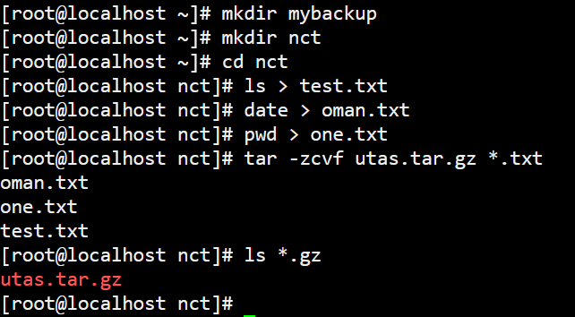
Backup Configuration
The tar command in Linux is one of the most widely used utilities for creating and extracting archives (collections of files) and for compressing them. It's essential for backup and data transfer tasks.
Step1: Create a directory mybackup and nct and inside nct directory create the following files as
mkdir mybackup
mkdir nct
cd nct
ls > test.txt
date > oman.txt
pwd > zero.txt
ps > one.txt
Step2:Compress all text Files with name of utas in nct directory:
tar -zcvf utas.tar.gz *.txt
-c Create a new archive
-v Verbose output (show files processed)
-f Specify the archive file
-z Compress using gzip
Step3:List only compressed files in nct directory:
ls *.gz

Slide 12
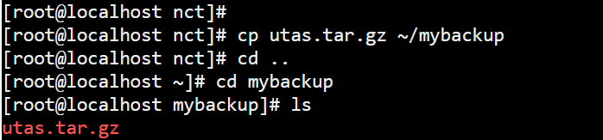
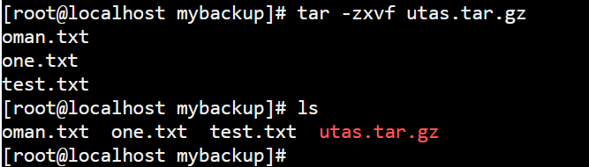
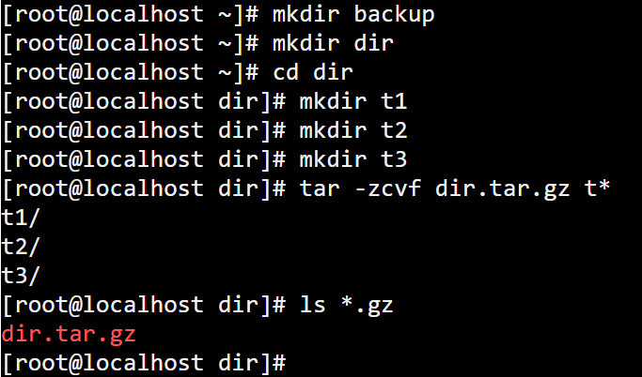
Extract Files:
Step 1: Copy compressed file utas.tar.gz to mybackup directory
cp ~/nct/utas.tar.gz ~/mybackup
Step2: Decompress utas.tar.gz file in mybackup directory
tar -zxvf utas.tar.gz
-c Create a new archive
-x Extract an archive
-v Verbose output (show files processed)
-z Compress using gzip
Step3: List all the files in mybackup directory ls
Backup Configuration :Compress and Decompress directories
Step1: Create a directory backup and dir and inside dir directory create
the following directories:
mkdir t1
mkdir t2
mkdir t3
Step2: Compress all directories start names with t in your dir directory.
tar -zcvf dir.tar.gz t*
-z: Compress using gzip
-c: Create a new archive
-v: Verbose mode (shows progress)
-f: File name of the archive
Step3:List only Compressed folders in dir directory:
ls *.gz

Slide 13
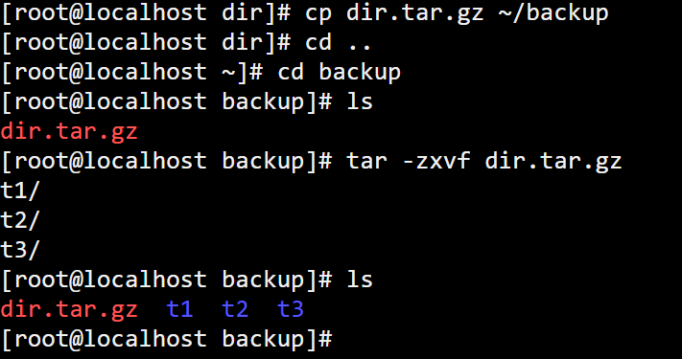
Extract Folders:
Step 1: Copy compressed file dir.tar.gz to backup directory
cp ~/dir.tar.gz ~/backup
Step2: Decompress dir.tar.gz file in backup directory
tar -zxvf dir.tar.gz
Step3: List all the folders in backup directory
ls

Slide 14
Chapter 10:
Advanced Storage Administration
Understand the importance of
Advance Storage
Understanding different RAID Levels
Create Logical Volume Management
(LVM)
Modifying Logical Volume
Management (LVM)

Slide 15
RAID (Redundant Array of Independent Disks) is a technology used to improve the performance, reliability, and availability of data storage systems. In Linux, RAID can be implemented through software or hardware.
Primary reasons to use RAID include:
• enhanced transfer speed
• enhanced number of transactions per second
• increased single block device capacity
• greater efficiency in recovering from a single disk failure

Slide 16
Level 0 RAID level 0, often called “striping”, is a performance-oriented striped data mapping technique. This means the data being written to the array is broken down into strips and written across the member disks of the array.
Level 1 RAID level 1, or “mirroring”, has been used longer than any other form of RAID. Level 1 provides redundancy by writing identical data to each member disk of the array, leaving a mirrored copy on each disk.
Level 4 RAID level 4 uses parity concentrated on a single disk drive to protect data. It is better suited to transaction I/O rather than large file transfers.
Level 5 The most common type of RAID is level 5 RAID. By distributing parity across some or all of the member disk drives of an array, RAID level 5 eliminates the write bottleneck inherent in level 4.

Slide 17
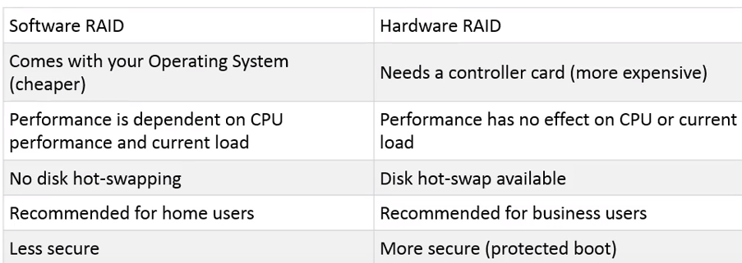
Hardware RAID
The hardware-based system manages the RAID subsystem independently from the host and presents to the host only a single disk per RAID array.
Software RAID
Software RAID implements the various RAID levels in the kernel disk (block device) code. It also offers the cheapest possible solution.

Slide 18
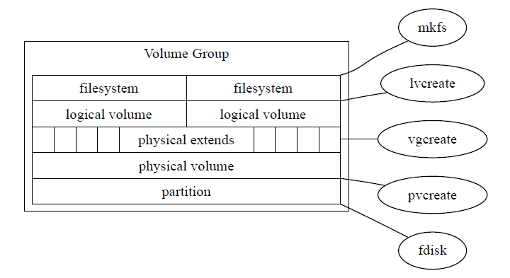
Configuring Logical Volume Management
lvm is a logical volume manager for Linux. It enables you to concatenate several physical volumes (hard disks etc.) to so-called volume groups, forming a storage pool, much like a virtual disk.

Slide 19
The mkfs (Make File System) command in Linux is used to create a filesystem on a disk partition or logical volume.
The lvcreate command in Linux is used to create a Logical Volume (LV) inside a Volume Group (VG), which is a core part of the LVM (Logical Volume Manager) system.
The vgcreate command in Linux is used to create a Volume Group (VG) in the LVM (Logical Volume Manager) system.
The pvcreate command in Linux is used to initialize a physical volume (PV) for use with LVM (Logical Volume Manager).
The fdisk command in Linux is a powerful tool used to create, delete, and manage disk partitions on MBR (Master Boot Record) disks.
Note:The above command works only on Ubuntu OS and does not work on JSLinux

Slide 20
Commands for Storage Administration
List all disks and partitions
lsblk
View partitions with sizes
fdisk -l
View disk usage
df -h
View estimate file and directory space usage
du -h
View list detailed information about your hardware
lshw
lshw -class cpu Show only CPU info
lshw -class memory Show RAM details
lshw -class disk Show disk and storage info
lshw -class network Show network interfaces
Note: The above command works only on Ubuntu OS and does not work on JSLinux

Slide 21
Steps to Create LVM in Ubuntu
1. Install LVM Tools (if not installed)
sudo apt update
sudo apt install lvm2
2. Create Physical Volume (PV)
This step initializes the disk for use with LVM.
sudo pvcreate /dev/sdX
Replace /dev/sdX with your target disk or partition (like /dev/sdb, /dev/sdc1, etc.)
Check with:
sudo pvs
Note: The above command works only on Ubuntu OS and does not work on JSLinux

Slide 22
Steps to Create LVM in Ubuntu
1. Install LVM Tools (if not installed)
sudo apt update
sudo apt install lvm2
2. Create Physical Volume (PV)
This step initializes the disk for use with LVM.
sudo pvcreate /dev/sdX
Replace /dev/sdX with your target disk or partition (like /dev/sdb, /dev/sdc1, etc.)
Check with:
sudo pvs
Note: The above command works only on Ubuntu OS and does not work on JSLinux

Slide 23
3. Create Volume Group (VG)
sudo vgcreate my_vg /dev/sdX
my_vg is your volume group name — you can name it anything.
Check with:
sudo vgs
4. Create Logical Volume (LV)
sudo lvcreate -L 10G -n my_lv my_vg
10G = size, my_lv = logical volume name, my_vg = your volume group.
Check with:
sudo lvs
Note: The above command works only on Ubuntu OS and does not work on JSLinux

Slide 24
5. Format the Logical Volume
sudo mkfs.ext4 /dev/my_vg/my_lv
6. Mount the Logical Volume
sudo mkdir /mnt/mydata
sudo mount /dev/my_vg/my_lv /mnt/mydata
Note: The above command works only on Ubuntu OS and does not work on JSLinux

